Slide 1
Employee Data Analysis using Excel
STUDENT NAME: R. SUJITHA
REGISTER NO: 312209869
MN ID: F1F08FA673D7CE2AA3048CB374E4ADFB
DEPARTMENT: B. COM (ACCOUNTING & FINANCE)
COLLEGE: VALLIAMMMAL COLLEGE FOR WOMEN

Slide 2
PROJECT TITLE
Employee DEPARTMENT Analysis using Excel

Slide 3


AGENDA
Project Overview
End Users
Our Solution and Proposition
Dataset Description
Modelling Approach
Results and Discussion
Conclusion
Problem Statement
3/21/2024 Annual Review

Slide 4

PROBLEM STATEMENT
* Department analysis for employees is to understanding of the distribution, performance, and satisfaction of employees across various departments. Its outlines the need for analysing different aspects of employees within departments, focusing on improving the organizations efficiency and employees satisfaction.

Slide 5

PROJECT OVERVIEW
Understand the distribution of employees across the various departments, including the number of employees in each department, roles and levels. Measures the satisfaction and engagement levels of employees in different departments.

Slide 6
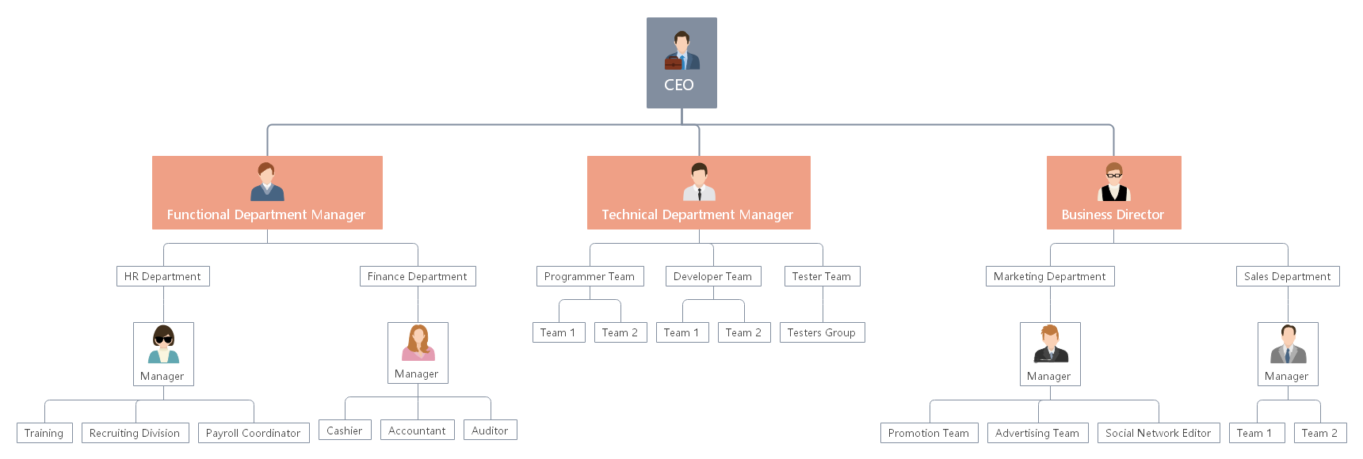

WHO ARE THE END USERS?

Slide 7

OUR SOLUTION AND ITS VALUE PROPOSITION Conditional formatting :Missing Filter : Remove Pivot table : Summary Graph : Data visualization

Slide 8
Dataset Description
Employee dataset - Edunet Features -26 Features Employee ID - Number Name -First and Last E-mail Department Job function description Gender -Female and Male Employee rating -Number

Slide 9

THE "WOW" IN OUR SOLUTION
Pivot table is to easily understand the employees in each department and the chart representation is easily identified the number of employees in each departments
3/21/2024 Annual Review
9

Slide 10
MODELLING
Data collection
Download from edunet
Feature collection
identify the feature
Cleaning
Identify the missing values
filter out the deleted Data values
Summary
pivot tables
Graph Representation
10

Slide 11
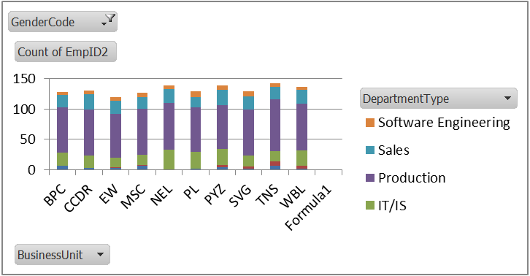
RESULTS
11

Slide 12
Conclusion To Conclude the employment department analysis overview of department highlights the number of employee in each department. Summarize the performance metrics used and how each department scored including productivity , efficiency and overall contribution to an organization

